Slide 1
Covid data analysis
SQL
Tableau
Queries
Data correlation
MILESTONE
MILESTONE
MILESTONE
MILESTONE
Importing data to PostgreSQL and connecting to it from Python
Writing queries in Python to get relevant data
Making sheets and a dashboard of relevant data
Processing data in Python and making diagrams and plots

Slide 2
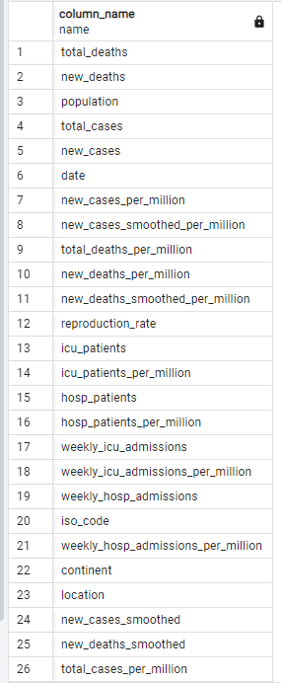
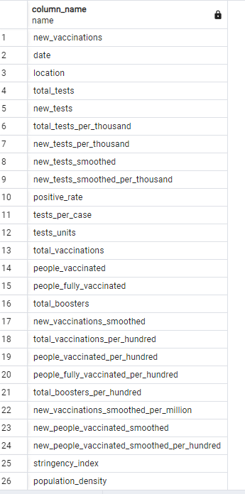
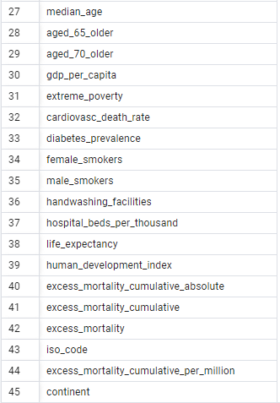
SQL
PostgreSQL
Running in Docker
Python script to make tables from csv
Covid Deaths
Covid Vaccinations

Slide 3
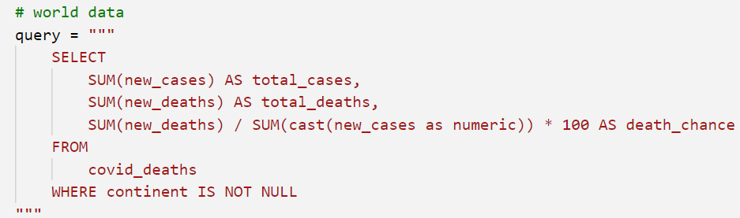
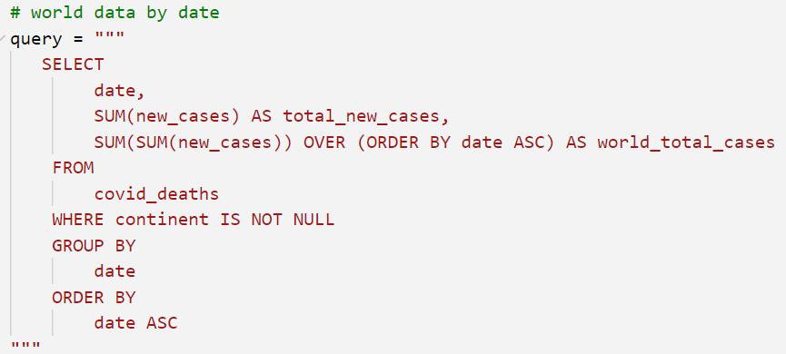
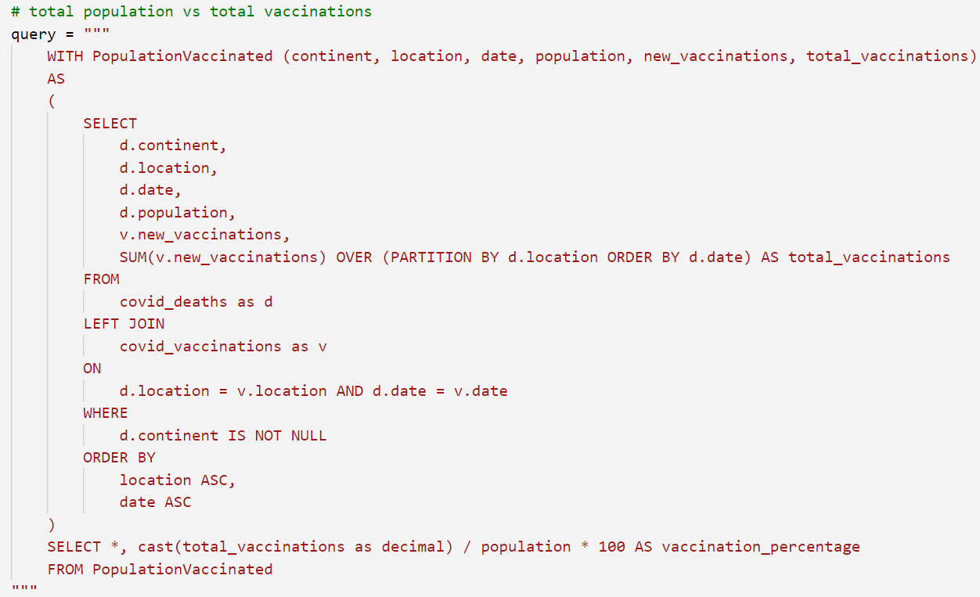
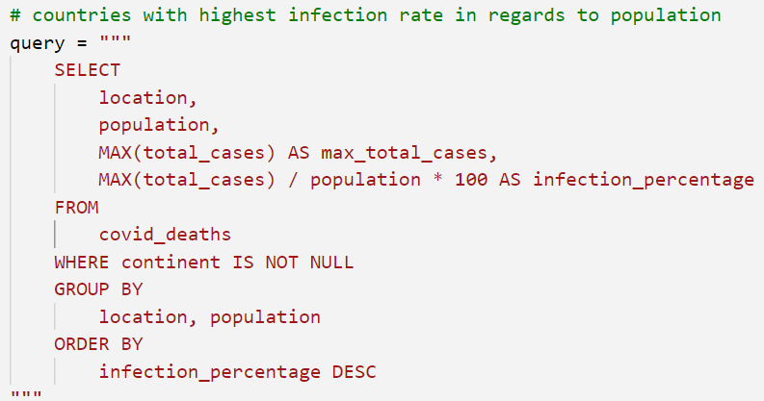
Queries
Written in Python
Read by pandas and put into data frames
Data frames clean query results
Query results saved to csv files

Slide 4
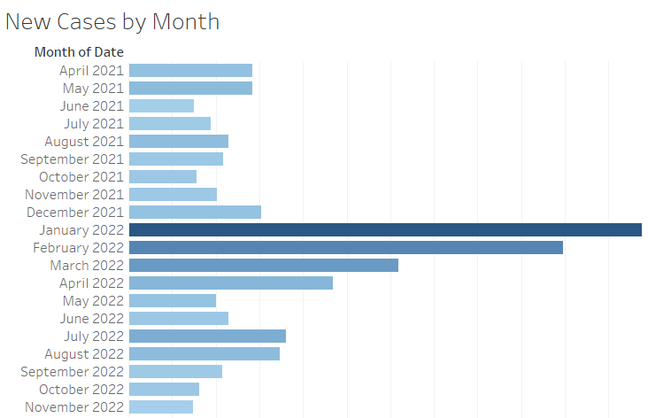
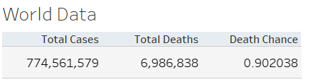
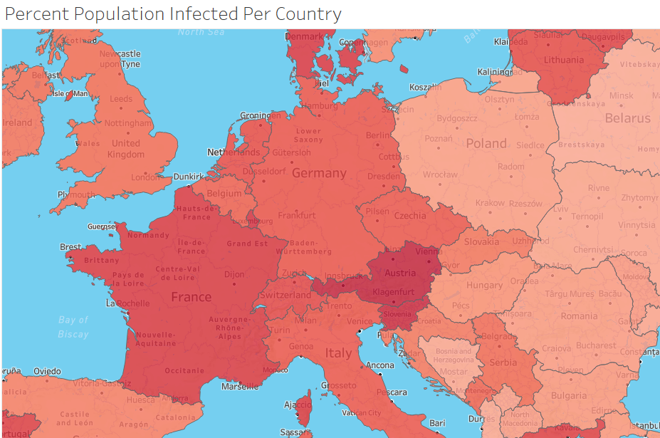
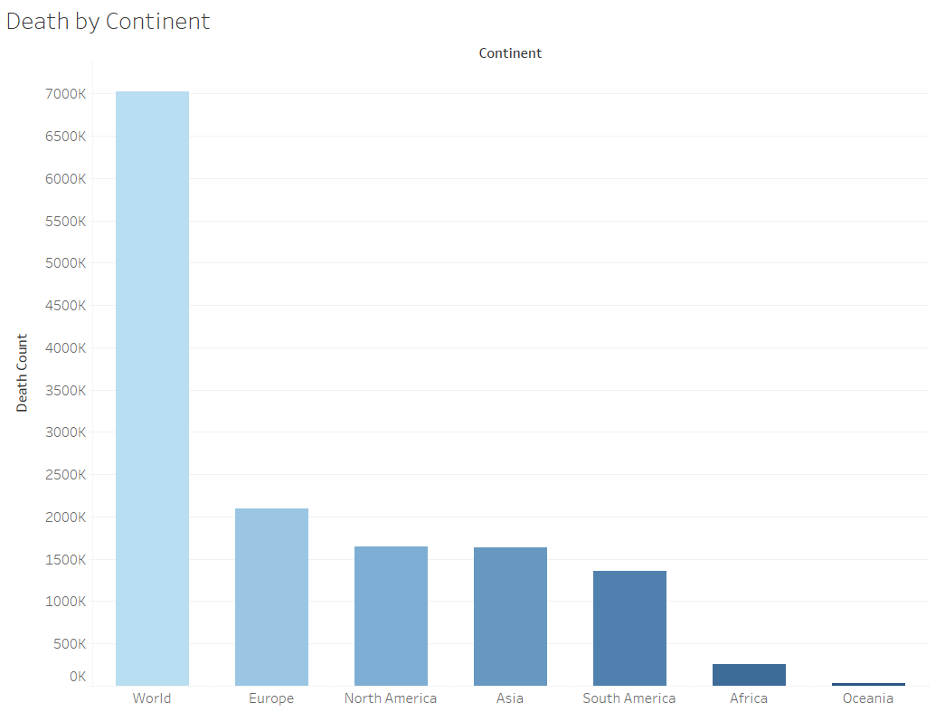
Tableau
- Visualization of query results

Slide 5
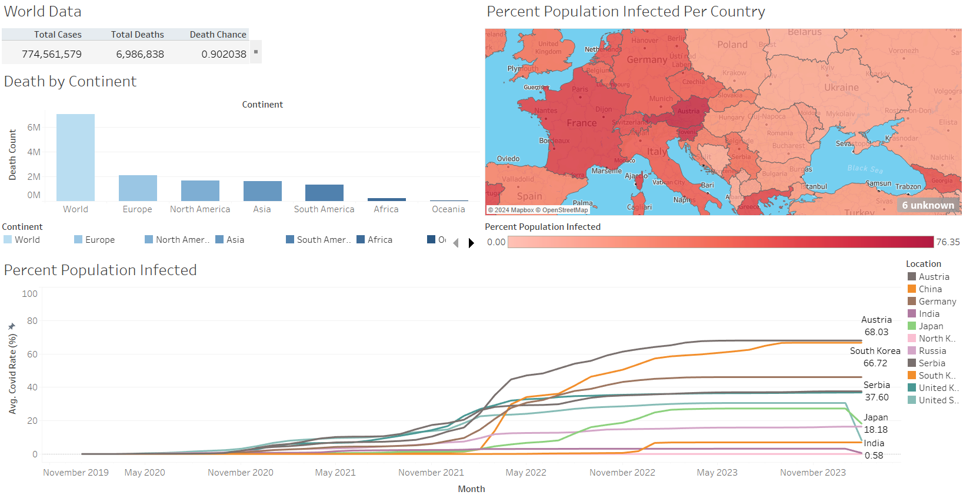
Tableau

Slide 6
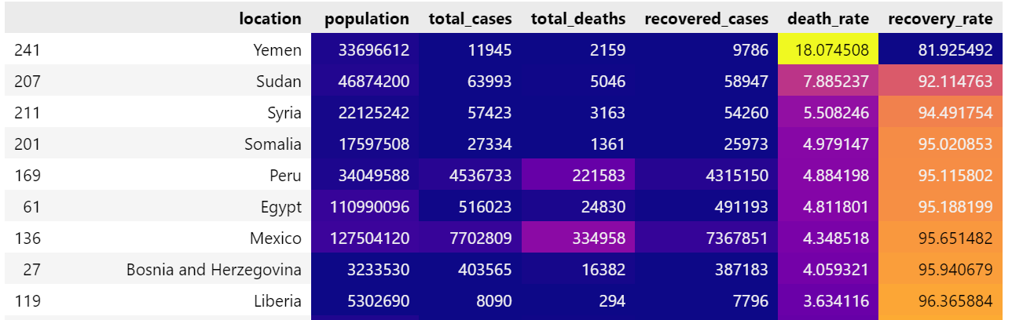
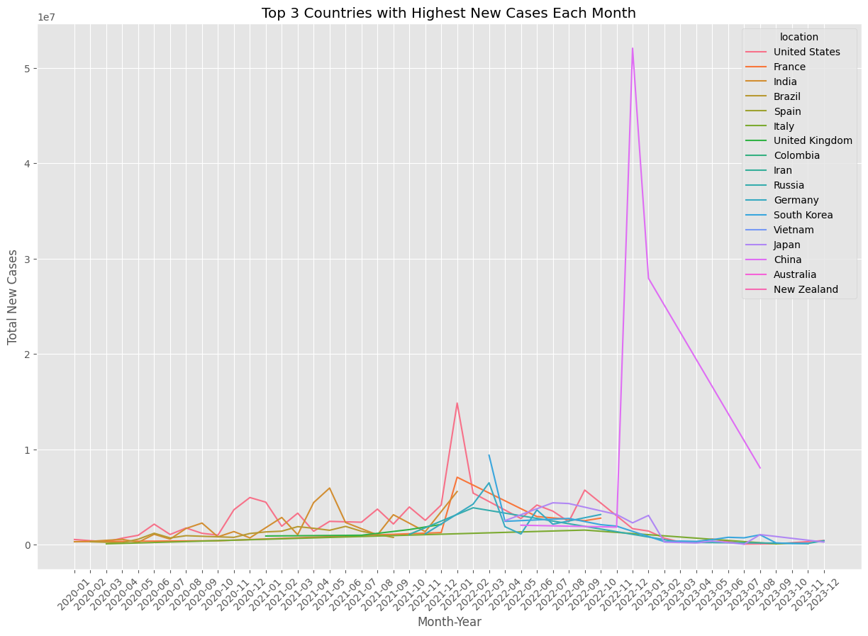
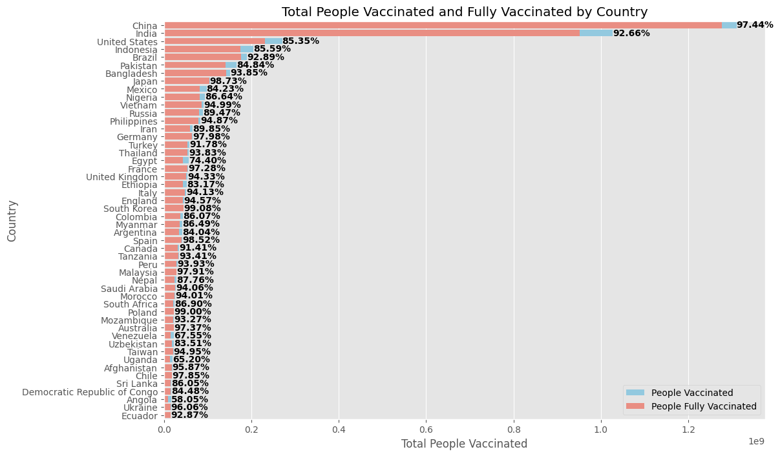
Data correlation
Reading csv files into data frames
Data cleaning
Diagrams and plots

Slide 7
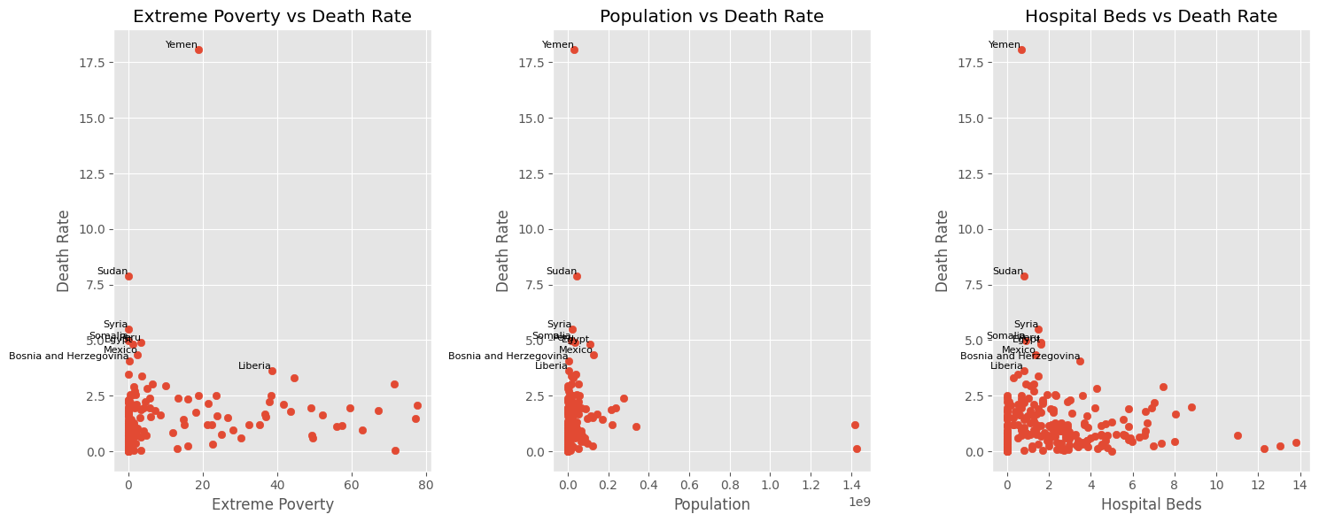
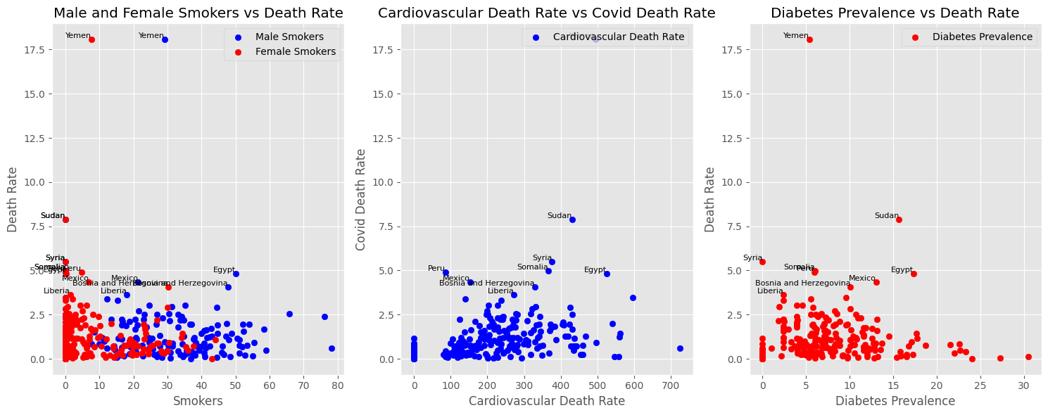
Data correlation

Slide 8
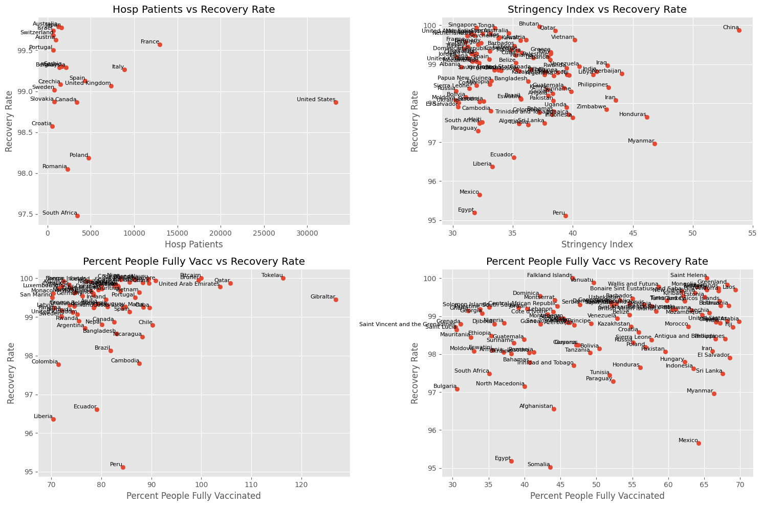
Data correlation

